Slide 1
Jenkins Automation
LogicOps Lab

Slide 2
Roadmap - Phase #1
Course Overview
Introduction to Jenkins, features, architecture, et cetera
Software development life cycle and DevOps culture
Jenkins – Getting started
Pipelines
What is Artifactory?
SCM – GitHub overview
CI and CD with Jenkins
A basic project using Maven
Bonus – Tips and Tricks

Slide 3
Roadmap - Phase #2
Course Overview
Jenkins - Advance concepts
Prerequisites
Building an app
IaaC and automation
Jenkins job DSL
Jenkins with Docker
Build, Test, Run everything
Jenkins integrations with the application
Other Jenkins concepts and Q/A

Slide 4

Introduction
Jenkins is a free and open-source automation server. It helps automate the parts of software development related to building, testing, and deploying, facilitating continuous integration and continuous delivery.
It is a server-based system that runs in servlet containers such as Apache Tomcat. It supports version control tools, including AccuRev, CVS, Subversion, Git, Mercurial, Perforce, ClearCase and RTC, and can execute Apache Ant, Apache Maven and sbt based projects as well as arbitrary shell scripts and Windows batch commands.

Slide 5
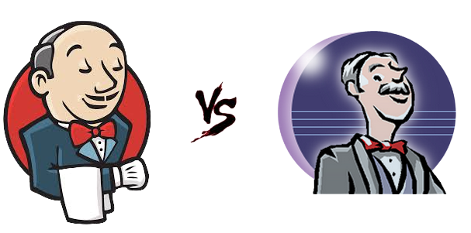

History
Originally – Hudson (2004)
Creator - Kohsuke Kawaguchi (Written in Java)
During November 2010, after the acquisition of Sun Microsystems by Oracle, an issue arose in the Hudson community with respect to the infrastructure used
Initial release – 2nd Feb, 2011
In 2011, creator Kohsuke Kawaguchi received an O'Reilly Open Source Award for his work on the Hudson/Jenkins project.
On April 20, 2016 version 2 was released with the Pipeline plugin enabled by default.The plugin allows for writing build instructions using a domain specific language based on Apache Groovy.
Jenkins replaced Hudson since February 8, 2017 in Eclipse.

Slide 6
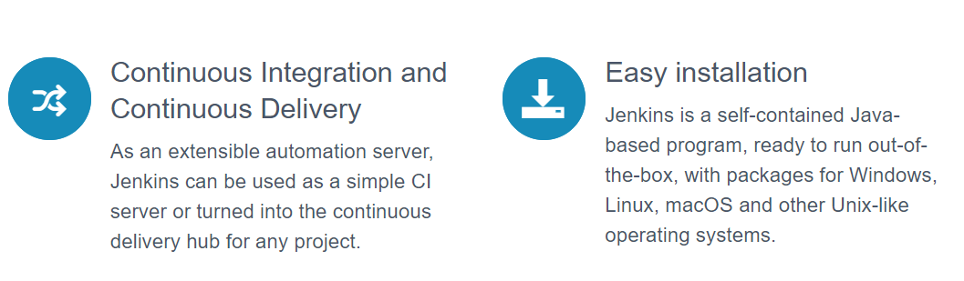
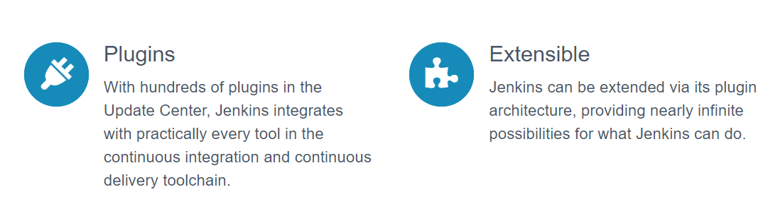
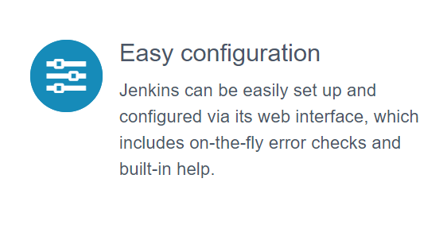
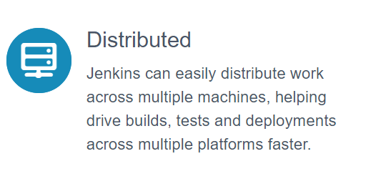
Features

Slide 7
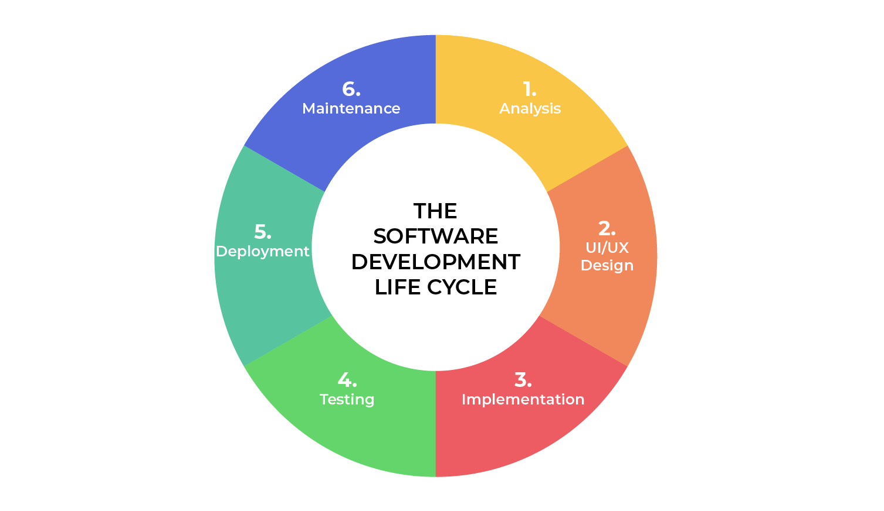
Software Development Life Cycle (SDLC)

Slide 8

Feasibility Studies
Economic: Can we complete the project within the budget or not?
Legal: Can we handle this project as cyber law and other regulatory framework/compliances.
Operation feasibility: Can we create operations which is expected by the client?
Technical: Need to check whether the current computer system can support the software
Schedule: Decide that the project can be completed within the given schedule or not.

Slide 9
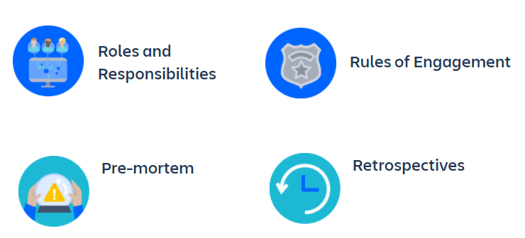
DevOps Culture
DevOps culture is all about a shared understanding between developers and operations, and sharing responsibility for the software they build. That means increasing transparency, communication, and collaboration across development, IT/operations, and "the business".

Slide 10
Jenkins – Getting Started
Prerequisites (Java installation)
Jenkins Download
Jenkins Installation
Other configurations
Accessing the application over the browser

Slide 11
Git and GitHub
What is Git?
Download and install
What is GitHub?
Account creation on GitHub
Basic commands to learn
Why do we need GitHub in this course?

Slide 12


Git
Git is the most widely used modern version control system in the world
Git was originally developed by Linus Torvalds
Git is an example of a DVCS (Distributed Version Control System)
In addition to being distributed, Git has been designed with performance, security and flexibility in mind.

Slide 13
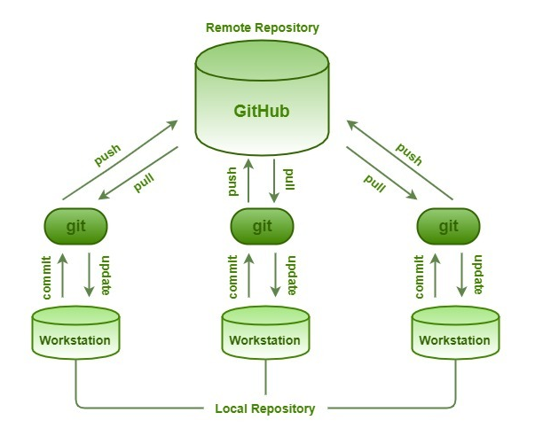
GitHub
GitHub, Inc. is a provider of Internet hosting for software development and version control using Git.
It offers the distributed version control and source code management (SCM) functionality of Git, plus its own features.
It provides access control and several collaboration features such as bug tracking, feature requests, task management, continuous integration and wikis for every project.
Headquartered in California, it has been a subsidiary of Microsoft since 2018.

Slide 14
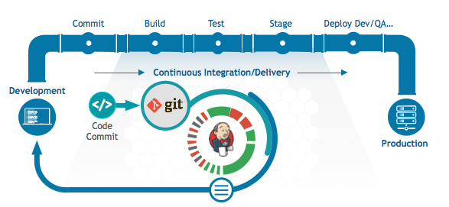
Pipelines
Pipeline is a suite of plugins which support implementing and integrating continuous integration/delivery into Jenkins
Pipeline provides an extensive set of tools for modeling basic to complex delivery and release pipelines.

Slide 15
Pipelines : Scripted
The scripted pipeline is a traditional way of writing the Jenkins pipeline as code. Ideally, Scripted pipeline is written in Jenkins file on web UI of Jenkins.
Unlike Declarative pipeline, the scripted pipeline strictly uses groovy based syntax. Since this, the scripted pipeline provides huge control over the script and can manipulate the flow of script extensively.
This helps developers to develop advance and complex pipeline as code.

Slide 16
Syntax : Scripted Pipeline
node ('node-1') {
stage(‘CheckOut') {
git “https://github.com/your_repo_name.git''
}
stage('Compile') {
sh “ Your commands here ”
}
}

Slide 17
Pipelines : Declarative
Declarative Pipeline is a relatively recent addition to Jenkins Pipeline which presents a more simplified and opinionated syntax on top of the Pipeline sub-systems.
Declarative Pipeline encourages a declarative programming model, whereas Scripted Pipelines follow a more imperative programming model.
Declarative type imposes limitations to the user with a more strict and pre-defined structure, which would be ideal for simpler continuous delivery pipelines.
Scripted type has very few limitations that to with respect to structure and syntax that tend to be defined by Groovy, thus making it ideal for users with more complex requirements.

Slide 18
Syntax : Declarative Pipeline
pipeline {
agent any
stages {
stage('First') {
steps {
echo "This is 1st stage"
}
}
stage('Second') {
steps {
echo "This is 2nd stage"
}
}
}
}

Slide 19
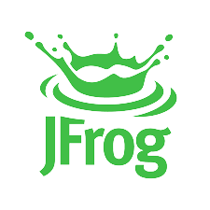
JFrog Artifactory
Why an artifactory?
Artifact - An artifact is any software asset that is connected to or part of a software project.
Management - These artifacts need to be stored and shared with all the developers on that project.
Quality, Consistency, and Accountability - All the artifacts need to be consistently managed, versioned, and deployed across development teams and sometimes across multiple sites, to ensure quality, reliability and auditability.

Slide 20
JFrog Integration with Jenkins
We need a JFrog plugin to do JFrog integration with Jenkins.
This integration allows you to add extra steps in your Jenkinsfile.
Once build is completed the artefact that you created will be sent to JFrog
Can be configured to only do this (usage) for the branch of your choice.
Branch can change depending on your workflow.

Slide 21
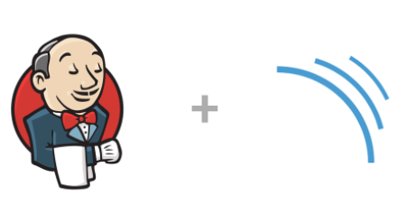
SonarQube & Integration with Jenkins (Part 1/2)
What is SonarQube?
Why SonarQube?
What are the benefits of SonarQube?
Download and Installation.
Logging in and basic walkthrough.

Slide 22
What is SonarQube?
Why SonarQube?
What are the benefits of SonarQube?
Sustainability
Increase productivity
Quality code
Detect Errors
Increase consistency
Business scaling
Enhance developer skills

Slide 23
SonarQube & Integration with Jenkins (Part 2/2)
Plugin installation.
Plugin configuration.
Integration with Jenkins pipelines.
Execution with a project and obtaining results.

Slide 24
E-Mail Notification & View Configuration
Upstream and Downstream jobs.
E-mail plugin for Jenkins.
Mail configuration for jobs.
How to send a success/failure mail for any build.
View creation for specific jobs.
Potential pitfalls.

Slide 25
Slack Integration with Jenkins
What is Slack?
Why Slack?
Free or Paid?

Slide 26
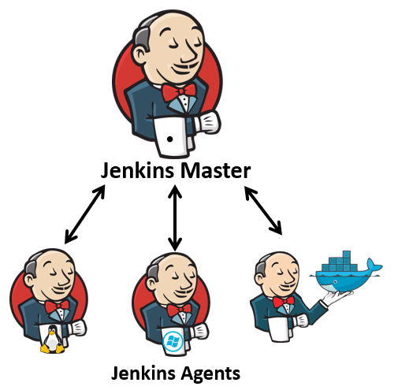
Jenkins – Master Slave : Concept & Architecture
What is Master Slave architecture?
Why do we need it?
How to configure it?
Demo.

Slide 27
Jenkins Master-Slave : Preface
52.191.26.213 - Jenkins Master Node (Windows) – A Virtual Machine running on Cloud.
192.168.1.6 - Jenkins Slave/Client/Agent (Windows) – My personal laptop.
Configuration check –
Inbound Jenkins port (8090 here) MUST be open on your Security Group (AWS).
Inbound Jenkins port (8090 here) MUST be open on your Network Interface (Azure).
Inbound Rule created in a Firewall MUST have Jenkins port (8090 here) open.
Same Java version on both MASTER and SLAVE.
Good internet connectivity.

Slide 28
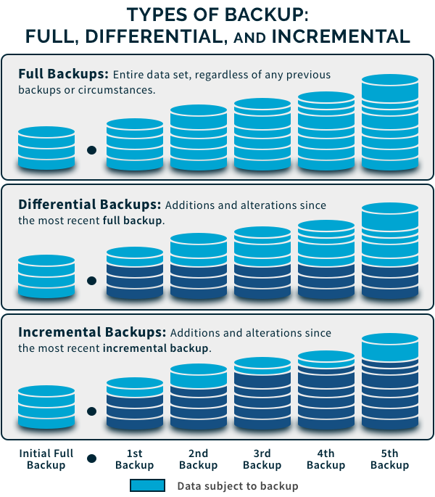
BackUp in Jenkins
Why do we need backup?
Types of BackUp
1) Full
2) Differential
3) Incremental

Slide 29
Multi-Branch Pipelines in Jenkins
What is Multi-Branch Pipeline?
Why do we need it?
Creation & Configuration.
Demo.

Slide 30
Prerequisites
Basic Linux commands
Basic of any language (we can take java) - Suggestion
What is Maven?
What is GIT?
What is GitHub?
What is Bit Bucket?
What is CI&CD?
What is Jenkins?
What is VM, Containers, Hypervisors?
What is Docker?
What is JFrog?
What is SonarQube?

